Slide 1


Self-healing Cloud Infrastructure with TICK stack, Vitrage and Mistral
Ha Noi, 24/08/2019

Slide 2




About
Mai Ngọc Dương
Cloud Administrator
Viettel Cyber Security
duongmn@viettel.com.vn
ATC in Openstack Kolla
Ngô Quang Hòa
Cloud Administrator
Viettel Cyber Security
hoanq13@viettel.com.vn
ATC in Openstack Vitrage

Slide 3
Agenda
Challenges
Current Solutions
Integrate external monitor to Vitrage
Demo
Summary

Slide 4
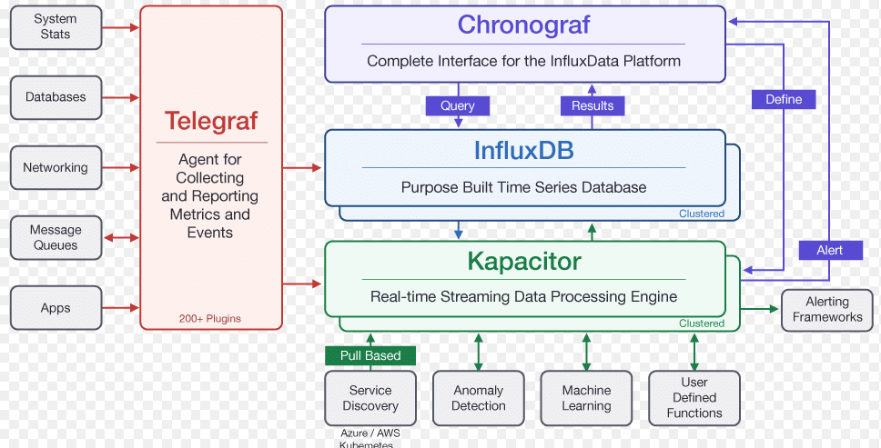
1. Challenges
Our current monitor stack: TICK
Infrastructure: Network device, Physical hardware status, Operating system, …
Backend services: MySQL, RabbitMQ, …
Applications: Company’s Application
https://www.influxdata.com/time-series-platform/

Slide 5
1. Challenges
Our current monitor stack: TICK
Pros:
Open source
Various application plugins
Push-based agent
Cons:
Need to pay for influxdb cluster
Other popular monitor stacks: Prometheus, Nagios, Zabbix, …

Slide 6

1. Challenges
Many errors can affect the cloud infrastructure :
Compute node:
Host down
NIC down
High CPU/Memory/Disk load
Physical hardware errors: HDD, SOC, Battery
Storage node:
OSD/Mon/Mgr, … down
Controller node:
Backend service down: RabbitMQ, MySQL
Service down, …

Slide 7
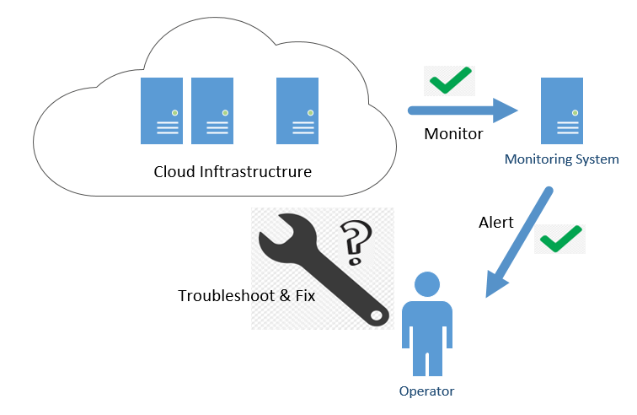
1. Challenges
Error Detection and Handling:
Detection:
Achieved by monitor systems
Handling:
Manual error troubleshooting & handling
Repeated process with known errors

Slide 8
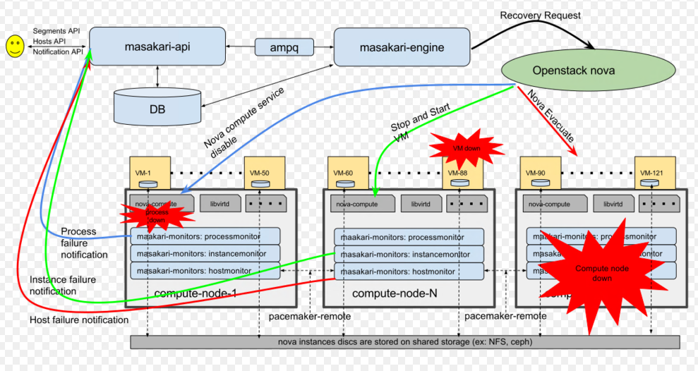
2. Current solutions
Masakari: provides Instances High Availability Service for OpenStack clouds
Monitor:
Host: based on pacemaker + corosync
Instance monitor
Process monitor
Action:
Fixed workflow (evacuate VM, …)
Call mistral workflow
https://wiki.openstack.org/wiki/Masakari

Slide 9
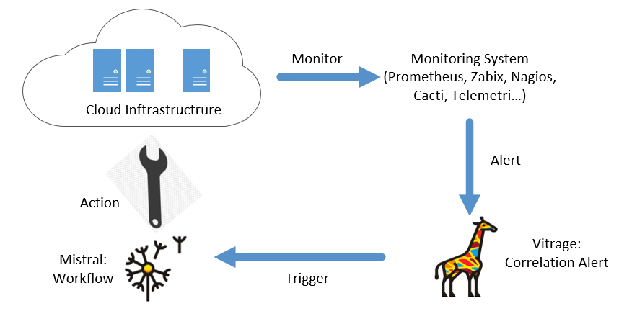
2. Current solutions
External Monitor + Openstack Vitrage + Mistral = Self Healing
External Monitor: Any monitor stack (TICK, Prometheus, Nagios, Zabbix, ..)
Openstack Vitrage: Based on alert and topology information to identify the affected components.
Mistral: Vitrage triggers Mistral workflow to handle known error

Slide 10
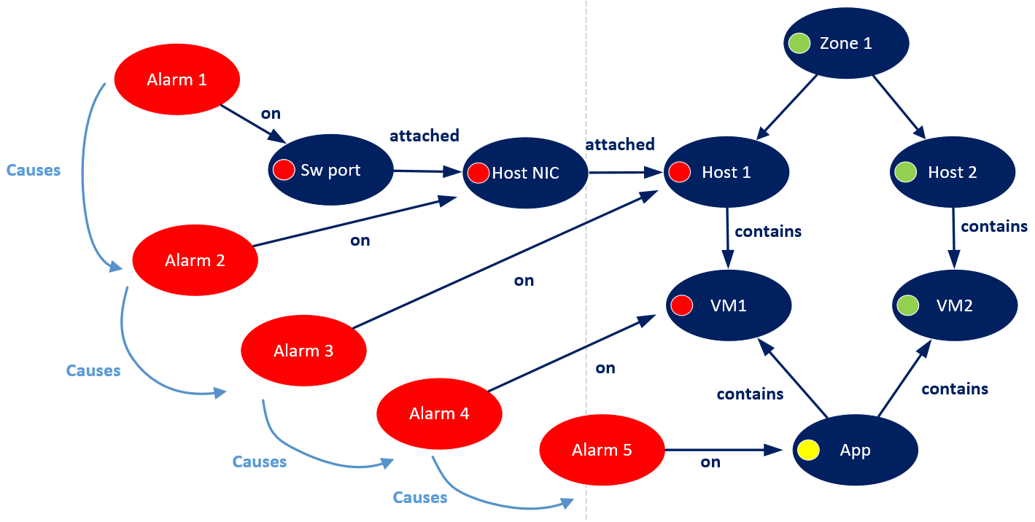
2. Current solutions
Vitrage: The Openstack Root Cause Analysis Service
Holistic and complete view: Physical-to-Virtual entities mapping
Deduced alarm, state
Root Cause Indicators
Notes:
Vitrage:
Holistic and complete view: Topology graph
Managed resources (AZ, compute, instance, volume, port): automatic discovery via openstack services
Unmanaged resources (Ovs-bridge, NIC, Switch, Storage, …) : Added manually by administrator
Deduced alarm, state:
Based on the topology graph, when vitrage receive an alarm, vitrage will known affected resources
Example: When a switch port is disconnected, vitrage will know which compute node or instance was affected
Root Cause Indicators:
When multiple alerts appear at the same time, based on the topology graph and the knowledge of errors entered by the administrator, the root cause of the problem can be determined.
Example: if there is an alert about a switch port down, and also many alert about disconnect to VMs, disconnect to applications, then Vitrage can specify the switch port down is the root cause of problem.

Slide 11
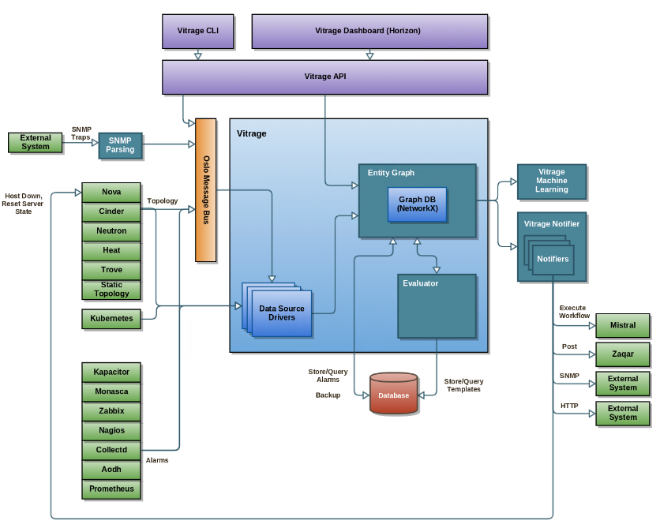
2. Current solutions
Vitrage: Architecture
Vitrage API, Dashboard, CLI
Vitrage Data Sources: Importing information from different sources (Openstack services and external) and pass them to Vitrage Graph.
Vitrage Graph: holds the information collected by the Data Sources, as well as their inter-relations.
Vitrage Evaluator: coordinates the analysis of (changes to) the Vitrage Graph and processes the results of this analysis.
Vitrage Notifiers: can be used to notify external systems of Vitrage alarms and states.
https://wiki.openstack.org/wiki/Vitrage
Notes:
Vitrage Data Sources are responsible for importing information from different sources, regarding the state of the system. This includes information regarding resources (physical, virtual, and applications) and alarms. The information is then processed into the Vitrage Graph. Currently Vitrage supports OpenStack datasources like Nova, Cinder, Neutron, Heat and Aodh, as well as external monitors like Nagios, Zabbix and collectd.
Vitrage Graph holds the information collected by the Data Sources, as well as their inter-relations. Additionally, it implements a collection of basic graph algorithms that are used by the Vitrage Evaluator (e.g., sub-matching, BFS, DFS etc).
Vitrage Evaluator coordinates the analysis of (changes to) the Vitrage Graph and processes the results of this analysis. It is responsible for executing different kind of template-based actions in Vitrage, such as to add an RCA (Root Cause Analysis) relationship between alarms, raise a deduced alarm or set a deduced state.
Vitrage Notifiers can be used to notify external systems of Vitrage alarms and states. The following notifiers are currently supported: Nova (update the states of the host and instances), Mistral (execute workflows), SNMP and HTTP webhooks

Slide 12
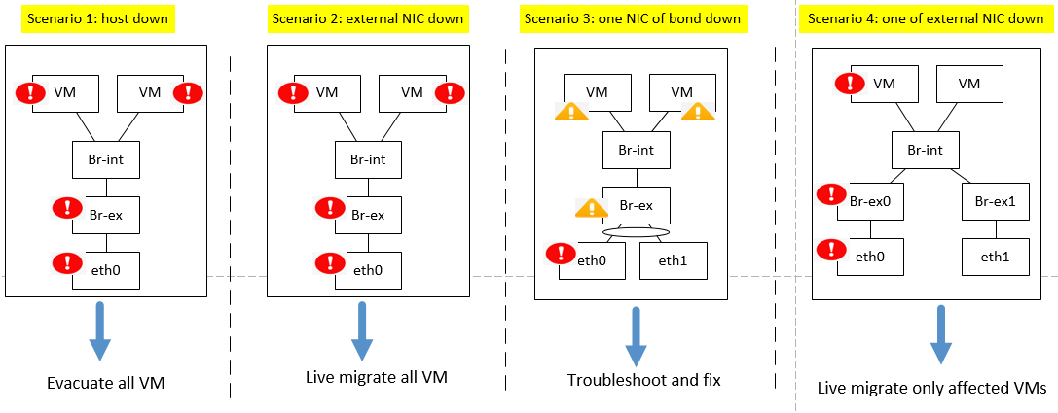
2. Current solutions
Question: If a network card on the compute node is down, how does it affect to the VMs, and what action should be take?

Slide 13
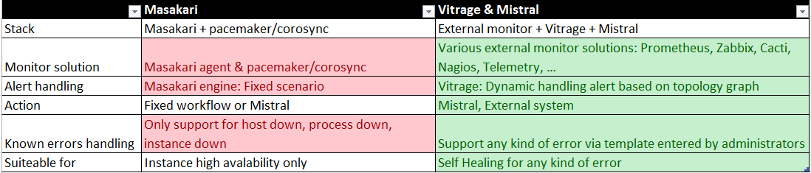
2. Current solutions
Maskari vs Vitrage & Mistral

Slide 14
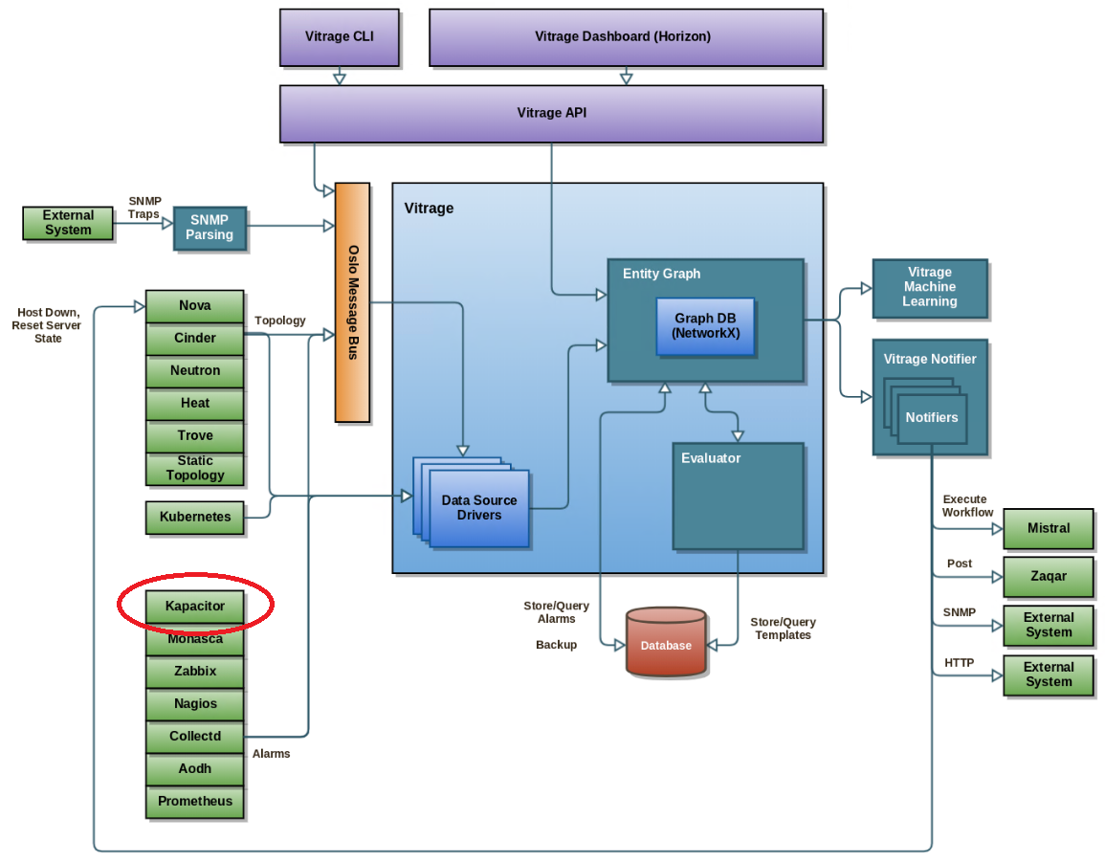
3. Integrate external monitor to Vitrage
Input: alert module of external monitor system
Target: Vitrage can receive and handle alerts

Slide 15
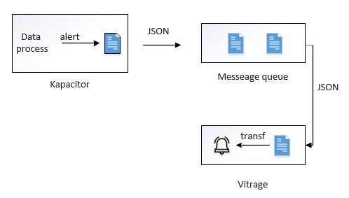
3. Integrate external monitor to Vitrage
Step 1: Send alert to message queue: topic vitrage_notifier
Step 2: Add Datasource Package (example: vitrage.datasource.kapacitor) with two classes:
Driver class: receive alert
Transformer class: transform alert to entity of vitrage graph

Slide 16
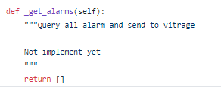
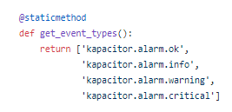
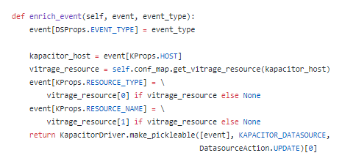
3. Integrate external monitor to Vitrage
Driver class
Function | Comments
get_all | Get alarm from external monitor tool
get_event_types | Get alarm from message queue
enrich_event | Add alarm information from config file

Slide 17
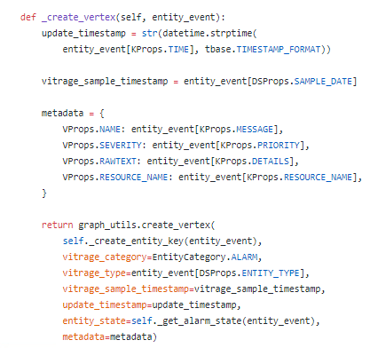
3. Integrate external monitor to Vitrage
Transformer class
Function | Comments
_create_vetex | Create a vertex for the graph
_create_neighbors | Create relationships with nearby vertices
https://docs.openstack.org/vitrage/latest/contributor/add-new-datasource.html

Slide 18
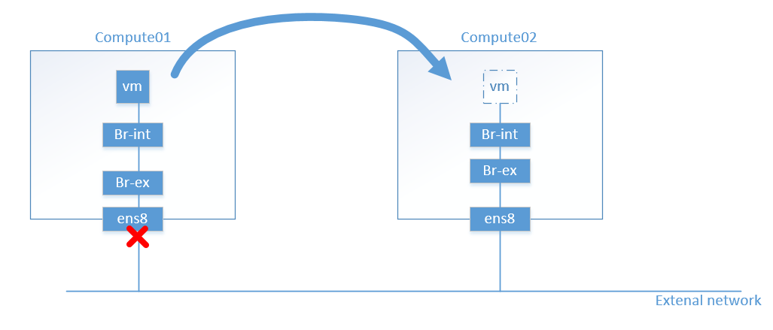
4. Demo
Scenario: Host NIC down

Slide 19
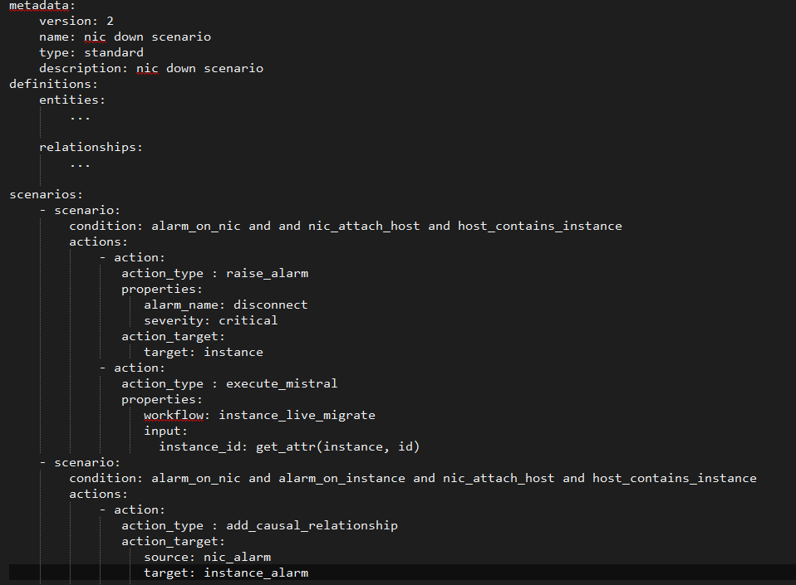
4. Demo
Template for NIC down scenario

Slide 20
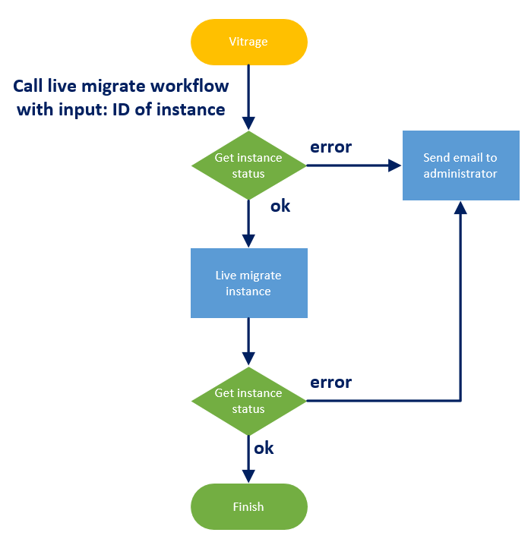
4. Demo
Mistral workflow: live migrate instance

Slide 21
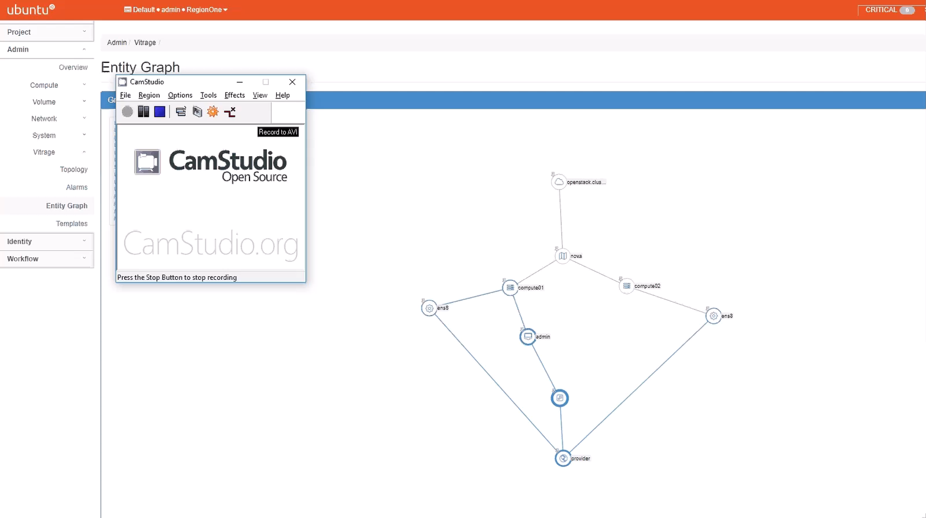
4. Demo

Slide 22
5. Summary
Summary:
Easy to support your own self-healing scenarios
Use Vitrage to quickly identify affected resources
Auto-healing for a specific instance upon a specific alarm
Solution can be extended to other use cases
Problem:
Vitrage does not support High availability for Vitrage graph. Currently Vitrage graph is in-memory NetworkX graph (may be change to Neo4j or Titan in the future).
Document: https://cloud-guru.github.io/monitors/

Slide 23


